Slide 1
JavaScript
IINF 362 Spring 2020

Slide 2
What is JavaScript (JS)?
It’s the 3rd major component of web technologies used for websites. It allows us to add interactivity to a web page. This can be in the form of manipulating user input or even updating content on the page dynamically.
HTML – Structure
CSS – Styles
JavaScript – Interactivity

Slide 3
Application Programming Interfaces (APIs)
JavaScript’s core language is powerful but the addition of APIs allows us to do more with less code.
The Document Object Model (DOM) is an example of an API used by JS. It allows us to manipulate HTML/CSS in our web page. This is an API built into the browser. Other APIs exist that are also built into the browser but some are 3rd-party APIs that you need to download or reference to use (Jquery for example).

Slide 4
How do we use it?
Similar to CSS, there are 3 main ways to use JS.
Internally
Inline
Externally

Slide 5
Internal JavaScript
This is placed in the HTML but between <script></script> tags.
Example:
<script>
alert(“Hello World!”);
</script>

Slide 6
Inline JavaScript
JavaScript
function sayHello() {
alert(“Hello World!”);
}
HTML <button onclick=“sayHello()”>Say Hello!</button>
In this example, a click event handler has been added to the HTML directly.

Slide 7
External JavaScript
HTML
<button id=“sayHello”>Say Hello!</button>
<script src=“script.js”></script>
JavaScript (in script.js file referenced above)
document.getElementById(“sayHello”).onclick = function sayHello() {
alert(“Hello World!”);
}
In this example, we place our javascript in an external file and use an ID to hook our function to the button click event.

Slide 8
Which way is best?
The best thing to do is use external JS. This means that you link your JS to your HTML via a script tag with a src attribute.
Place your JS link right before the closing body tag as demonstrated below:
<script src=“script.js”></script>
</body>
</html>

Slide 9
Why External and bottom of page?
Keeping your HTML/CSS/JS separated allows for easier code maintenance.
The HTML has to load before the JS can link to it. If a button hasn’t loaded and JS references it beforehand, your code may not work. This is why you place it before the closing body tag (</body>) in your HTML document.

Slide 10
Comments in JS
Comments are useful for leaving explanations or other bits of info inside of your code without affecting the code itself.
// Single line comment
/* This is
A comment
On multiple lines */

Slide 11
Variables
These are containers for values that can be changed or manipulated at any time.
var name = “Chris”;
var age = 25;
var likesMustard = false;
Some basic variables types are strings, numbers, and booleans.

Slide 12
Global Variables
Global variables usually appear outside of functions and can be used anywhere in your code.
<script>
var x = 5;
var myFunction = function() {
// code in here can use x
}
</script>
Since x is global (not in a function), it can be used by a function later in the code.

Slide 13
Local Variables
These can only be used inside of the function they are declared in.
<script>
var x = 5;
// Can’t access y out here
var myFunction = function() {
var y = 6;
// Can access x out here because it’s global
}
</script>
Since y is in our function, it can only be accessed in that function unless we make it global (not good practice).

Slide 14
Variable Naming Conventions
Names must begin with a letter or underscore
Names can have only letters, digits, underscores, and dollar signs (Jquery)
Some words are reserved
Variables are case-sensitive i.e. ‘var x’ is different from ‘var X’

Slide 15
Basic Operators
These allow us to perform calculations, combine strings, or even compare values.
var x = 1;
var y = 2;
x + y; // 3
x – y; // -1
x * y; // 2
x / y; // .5
y % x // 0 (modulus – it finds the remainder)
The ‘=‘ is an assignment operator. It says that the value on the right is assigned to the variable on the left. In the example above, x is assigned a value of 1.

Slide 16
More Operators
If we have a variable that needs a calculation performed on itself, we can use a shortcut.
Regular Way:
Var x = x + 1;
Shortcut:
Var x +=1;
We can do this with all of the other operators as well (-=, *=, /=, %=)

Slide 17
String Operator
We can combine (“concatenate”) strings using the “+” operator.
Var firstName = “Chris”;
Var fullName = firstName + “ Velez”;
Keep in mind that you have to add in spaces before and after words as the “+” operator doesn’t do it automatically.

Slide 18
Comparison Operators
== equal to
=== equal value and equal type
!= not equal
!== not equal value and not equal type
> greater than
< less than
>= greater than or equal to
<= less than or equal to

Slide 19
Logical Operators
&& - both cases must be true
|| - either case must be true
! – not operator

Slide 20
JS Conditions
var age = 25;
if (age > 13 && age < 18) {
console.log(“You are a teen.”);
} else if (age >= 18 && age <= 64) {
console.log(“You are an adult”);
} else {
console.log(“You’re a senior citizen”);
}

Slide 21
Conditions Explained
Conditions work from top to bottom executing whatever is inside of the “if” or “else if” statements. If they are evaluated to true, then the code inside the block is executed.
if(age > 25) {
// do stuff
} else if (age < 25) {
// do stuff if the first condition is false
} else {
// do other stuff if everything above is false
}

Slide 22
Arrays
var animals = [“cow”, “horse”, “pig”, “duck”];
Arrays are essentially just containers for variables.
To access any of the array elements, we would type ‘animals[x]’ where x is some number. 0 is always the first item of the array. To access “duck” we would use animals[3]. Arrays can hold any kind of variables, including other arrays.

Slide 23
Loops in JavaScript
Sometimes we need to complete a repetitive task like outputting 1-100 to a page.
We could say console.log(1); console.log(2); etc., but that would take a long time. We will focus on 2 main types of loops: for and while.

Slide 24
For Loops
Usually used for when you know exactly how many times a loop should run.
Example:
for(x = 1; x <= 10; x++) {
console.log(x);
}
This would output the numbers 1-10. The loop needs a set of parenthesis for the loop info and a set of curly braces to hold the instructions to be executed during each loop.

Slide 25
For Loops Continued
Example:
for(x = 1; x <= 10; x++) {
console.log(x);
}
The first part (x=1) tells us where to begin our loop. The second part (x <= 10) tells us where our loop will end. The last part (x++) tells us how much to increment our loop.
This loop starts at 1 and ends at 10. It will increment by 1 every time it loops.

Slide 26
While Loops
var x = 1;
while(x <= 10) {
console.log(x);
x++;
}
This loop does the same thing as the last one (prints 1-10). The main differences are where we place our code for where we start and how much we increment our values. While loops are generally used when we aren’t sure when the loop should end.

Slide 27
Caution
Each kind of loop needs a way to exit or it will cause a users’ browser to crash.
Consider the following:
var x = 0;
while(x <= 10) {
console.log(x);
}
Since x never increments, the value will always be 0 and therefore never reach 10. This results in a loop that doesn’t end. Make sure to include x++ or a similar way to exit your loops.

Slide 28
Functions
Functions are chunks of code wrapped up into one convenient place.
Example:
var myFunction = function() {
for(x=1; x<=100; x++) {
console.log(x);
}
}
myFunction(); // This one line of code will output the numbers 1-100
Notes:
The above code is the same as typing:
function myFunction() {
for(x=1; x<=100; x++) {
console.log(x);
}
}
myFunction();

Slide 29
Function Arguments/Parameters
Functions can take in arguments which are values the function will manipulate in some way.
var myInfo = function(name, age) {
console.log(“your name is “ + name + “ and you are “ + age + “ years old.”);
}
myInfo(“Chris”, 25); // Outputs your name is Chris and you are 25 years old.

Slide 30
Accessing the DOM
You can access elements in the DOM with a number of methods. The easiest one we have learned in class is document.getElementByID(“”);
var nameInput = document.getElementById(“name”);
Here we are grabbing the element with an id of “name” to be used for later.

Slide 31
Grabbing User Input
<input type=“text” name=“fname” id=“fname”>
<button type=“button” id=“submit”>Submit</button>
document.getElementById(“submit”).onclick = function() {
document.getElementById(“fname”).value;
}
The code above will look for an element with an id of “submit” to be clicked. Once it is clicked, we grab the value of the input. If we grab the input before the button is clicked, the user may not have typed anything yet and our result would be empty.

Slide 32
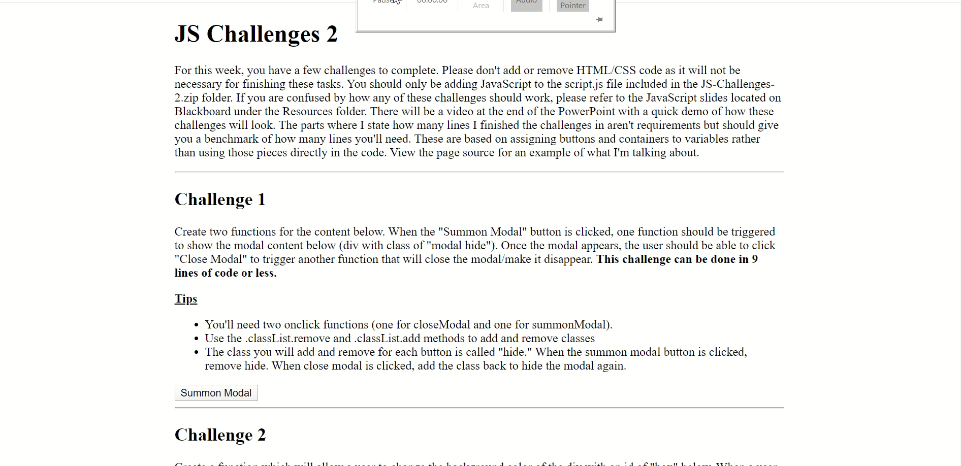
JS Challenges 2 Demonstration
Notes:
For challenge 1, the user should be able to click “Summon Modal” to make the modal appear. When the modal appears, they should be able to click “Close Modal” to make it disappear.
For challenge 2, the color of the box below the button should change to whatever is input in the box (red, blue, etc.).
For challenge 3, the user should be able to select any number of burgers, hotdogs, fries, or drinks and have their total be output along with how many of each they wanted.
For challenge 4, the user should be able to type in a comma-separated list of hobbies. After clicking submit, those hobbies should appear on the page in a list.

